Slide 1
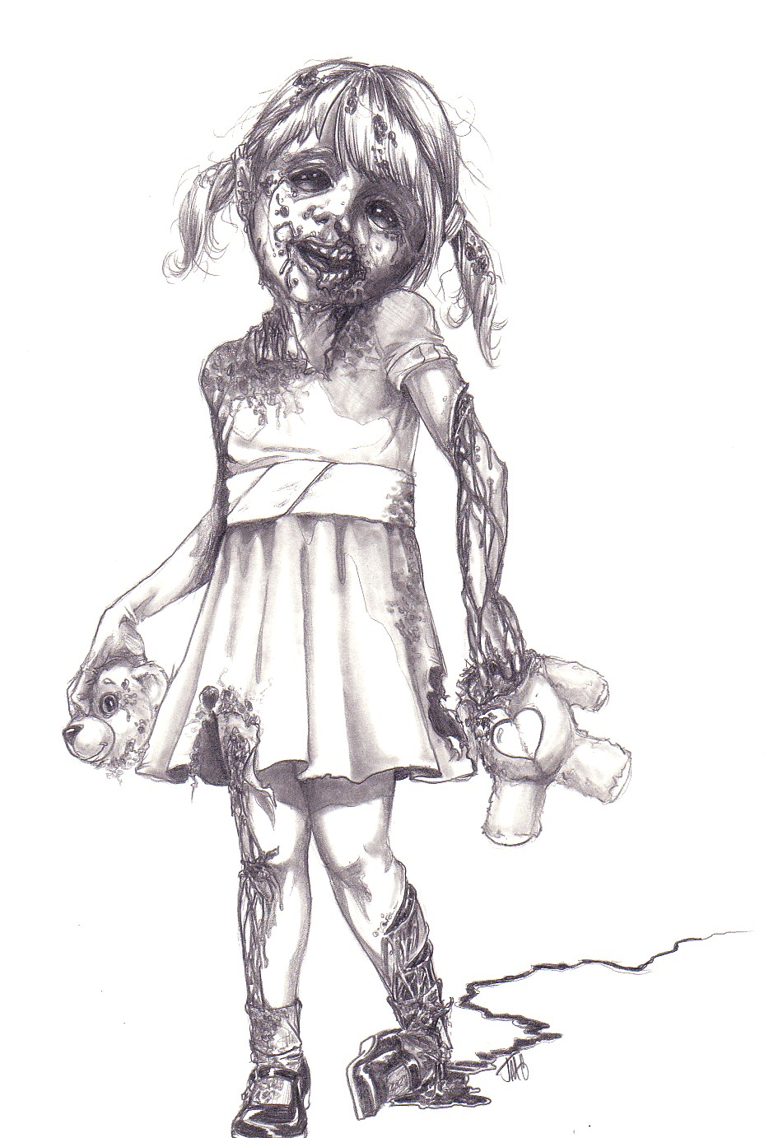

Project Zombie and Medusa
Jim Kurtz
Jim Oates
Karen B. Fine

Slide 2
Project Zombie – CARs that never die!!
Zombie
Categorization of all 2013 CARs
All = Globally
1398 CARs
From all sources
Internal, external
From all sites
Observations, Findings and OFI’s

Slide 3
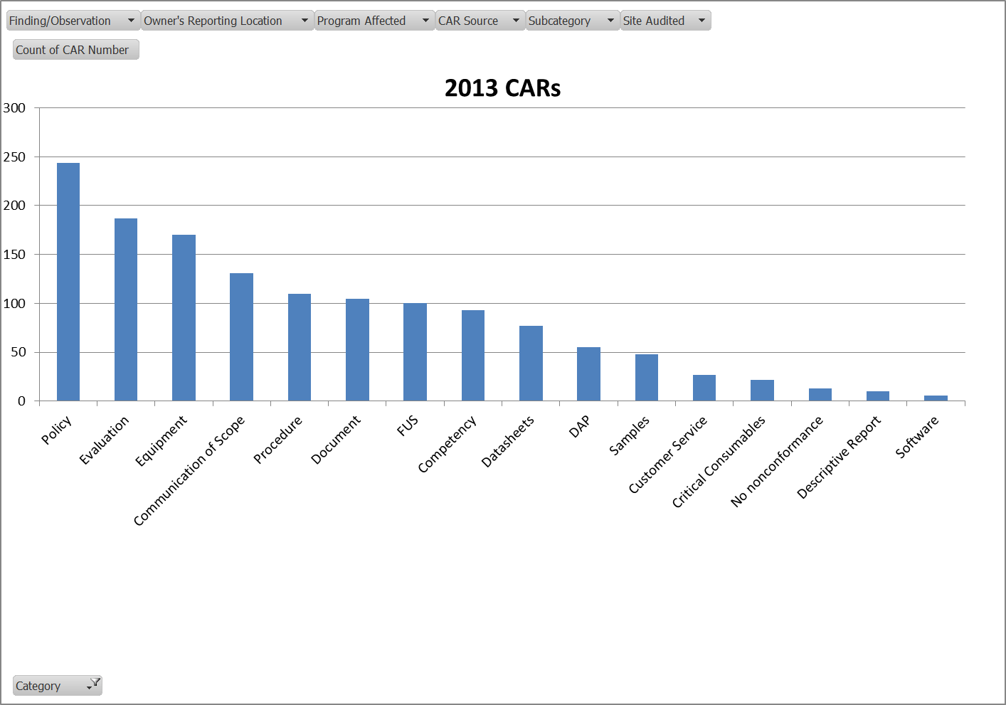
All CARs by Category

Slide 4
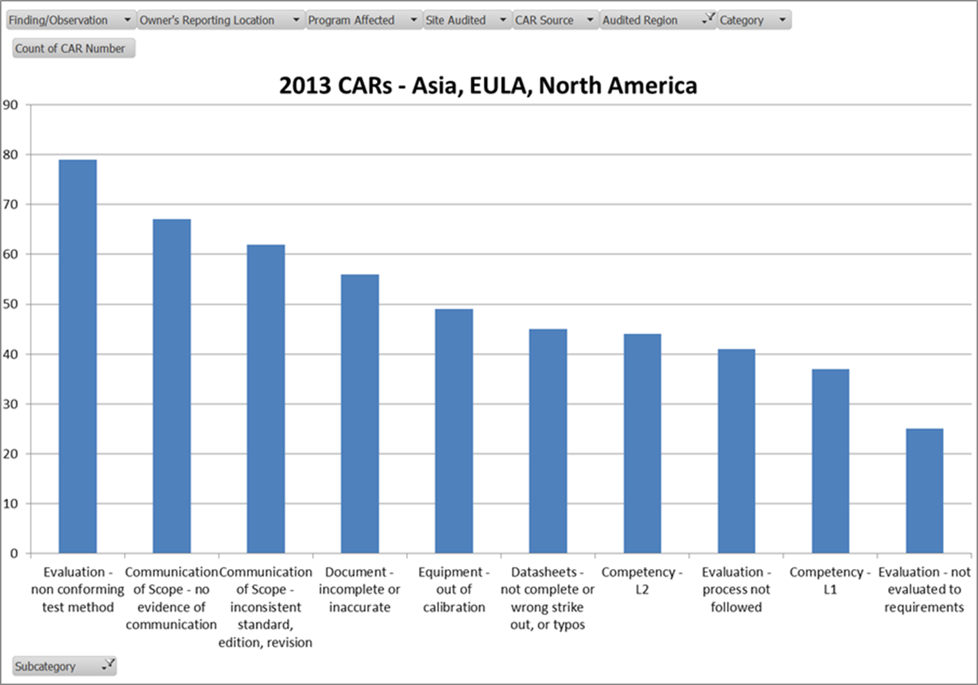
All Melville by Category

Slide 5
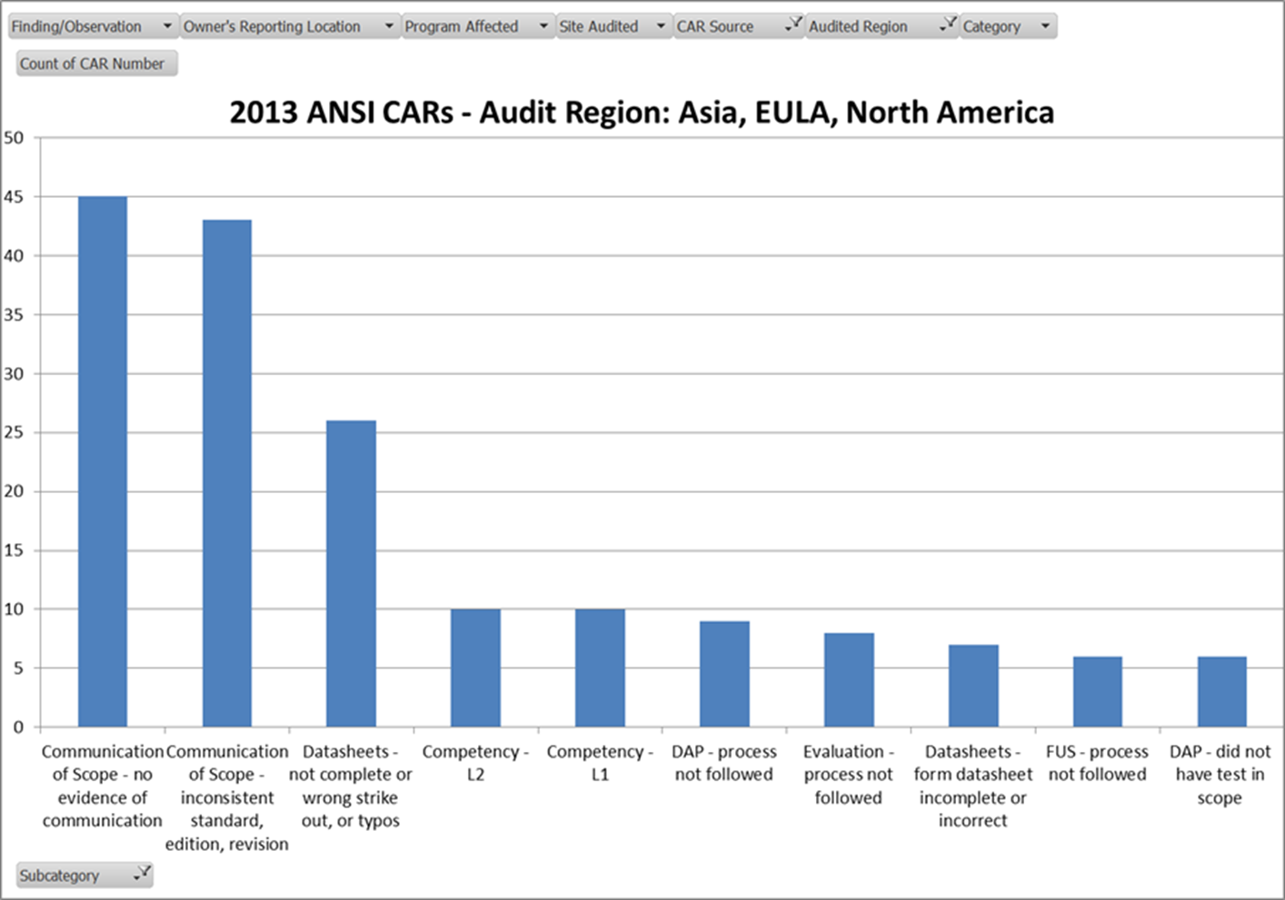
All Melville by Sub Category
Remaining subcategories 1 CAR

Slide 6
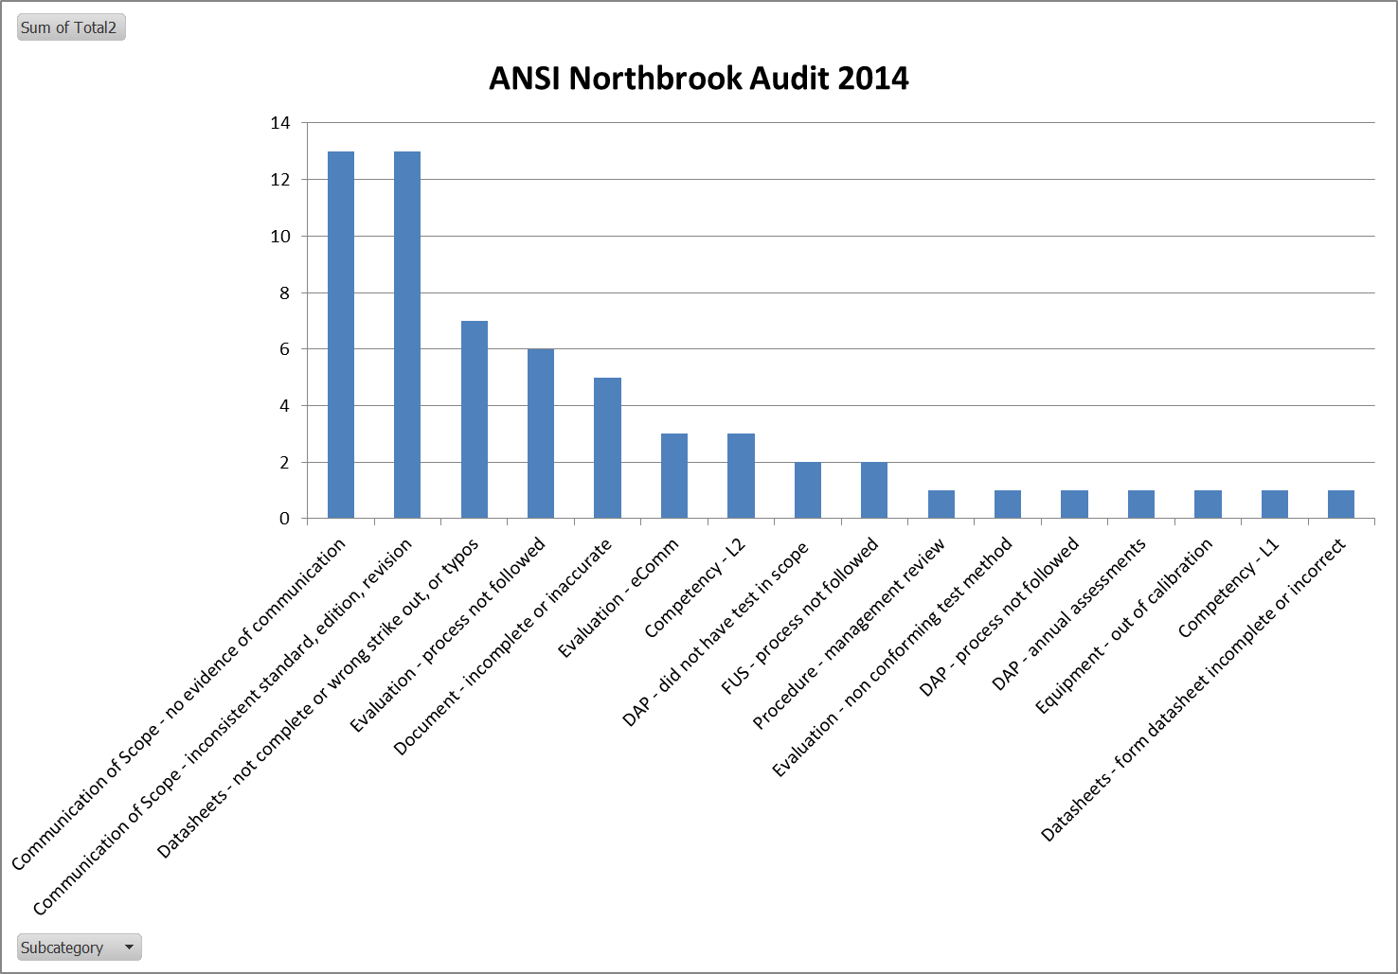
Are we still making the same mistakes? YES!

Slide 7
Project Medusa ̶ Ugly data with 1 look could turn you into stone
Medusa
Project Sampling (NOT AN AUDIT)
Sample size determined by number of closed projects from previous week involving datasheets (ANSI/ASQ Z1.4)
UL Labs and DAP
Currently checking 12 known non-conformances
Additional items can be added if spotted
No CARs are written

Slide 8
Reviewed items

Slide 9
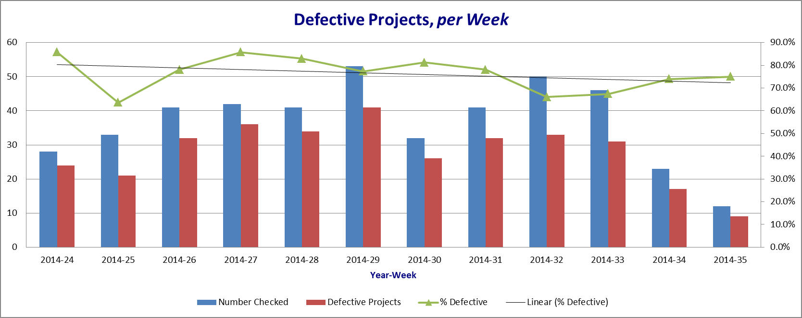
Medusa Results

Slide 10

Have we learned our lesson? NO!
Are our corrective actions eradicating
the problem? NO!

Slide 11
Completed Project Checks June 8– August 29
*percentage based on the number of projects with the condition, having the stated issue

Slide 12

What can we do about this?
How can we help the organization?
How can we help the CAR admins?
Medusa = Real Time Data

Slide 13
Closing Comments
We are sharing this information to all CAS and LAB to increase awareness
We can show you how to sample projects
Medusa can support CAR & tech audit scope and effectiveness of corrective actions
Most of the items that are being checked are manual processes
Too many incidents to believe this is human error

Slide 14

Questions?

